Slide 1
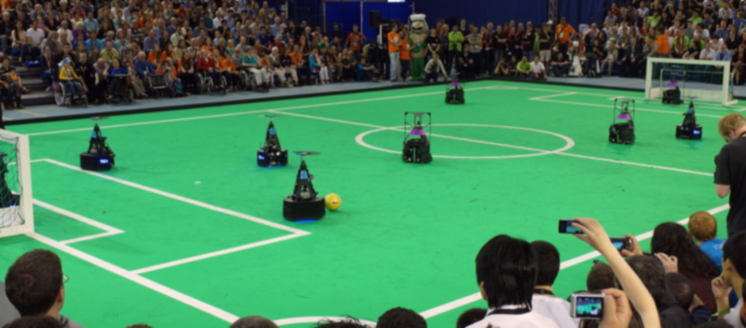
Stakeholder meeting- AutoRef
23/02/2024
Quinten Swaan, Project Manager
Department of Mathematics and Computer Science, EngD. Mechatronic Systems Design

Slide 2
Goal of meeting
To update on progress and discuss how to best proceed with technical requirements

Slide 3
Agenda
Work previous week
Project scope
Challenges and edge cases
Requirements
Summary
14:00 – 14:10
14:10 – 14:15
14:15 – 14:35
14:35 – 14:55
14:55 – 15:00

Slide 4
Previous week
Choose an interesting technical challenging scope and understand the problem.
Talked with RoboCup referee
Limited project scope further based on interest and challenges
Challenges
Edge cases
Translation into technical requirements

Slide 5
Further limited project scope
RC-12.3.4 & RC-12.3.5. Illegal Defense & Attack. Max 1 player in penalty area for 10s.
Not yet implemented → Progress
Hard for human referees → Objectivity
Easy to implement
Who touched the ball last time for the award of FL-15, FL-16, FL-17.
Not yet implemented → Progress
Very common rule
Send decisions to RefBox → Communication
Not yet implemented → Progress
Notes:
Deniz?

Slide 6
Further limited project scope
RC-12.3.4 & RC-12.3.5. Illegal Defense & Attack. Max 1 player in penalty area for 10s.
Not yet implemented → Progress
Hard for human referees → Objectivity
Easy to implement
Who touched the ball last time for the award of FL-15, FL-16, FL-17.
Not yet implemented → Progress
Very common rule
Send decisions to RefBox → Communication
Not yet implemented → Progress
Notes:
Deniz?

Slide 7
Project scope
Who touched the ball the last time?
Notes:
Deniz?

Slide 8
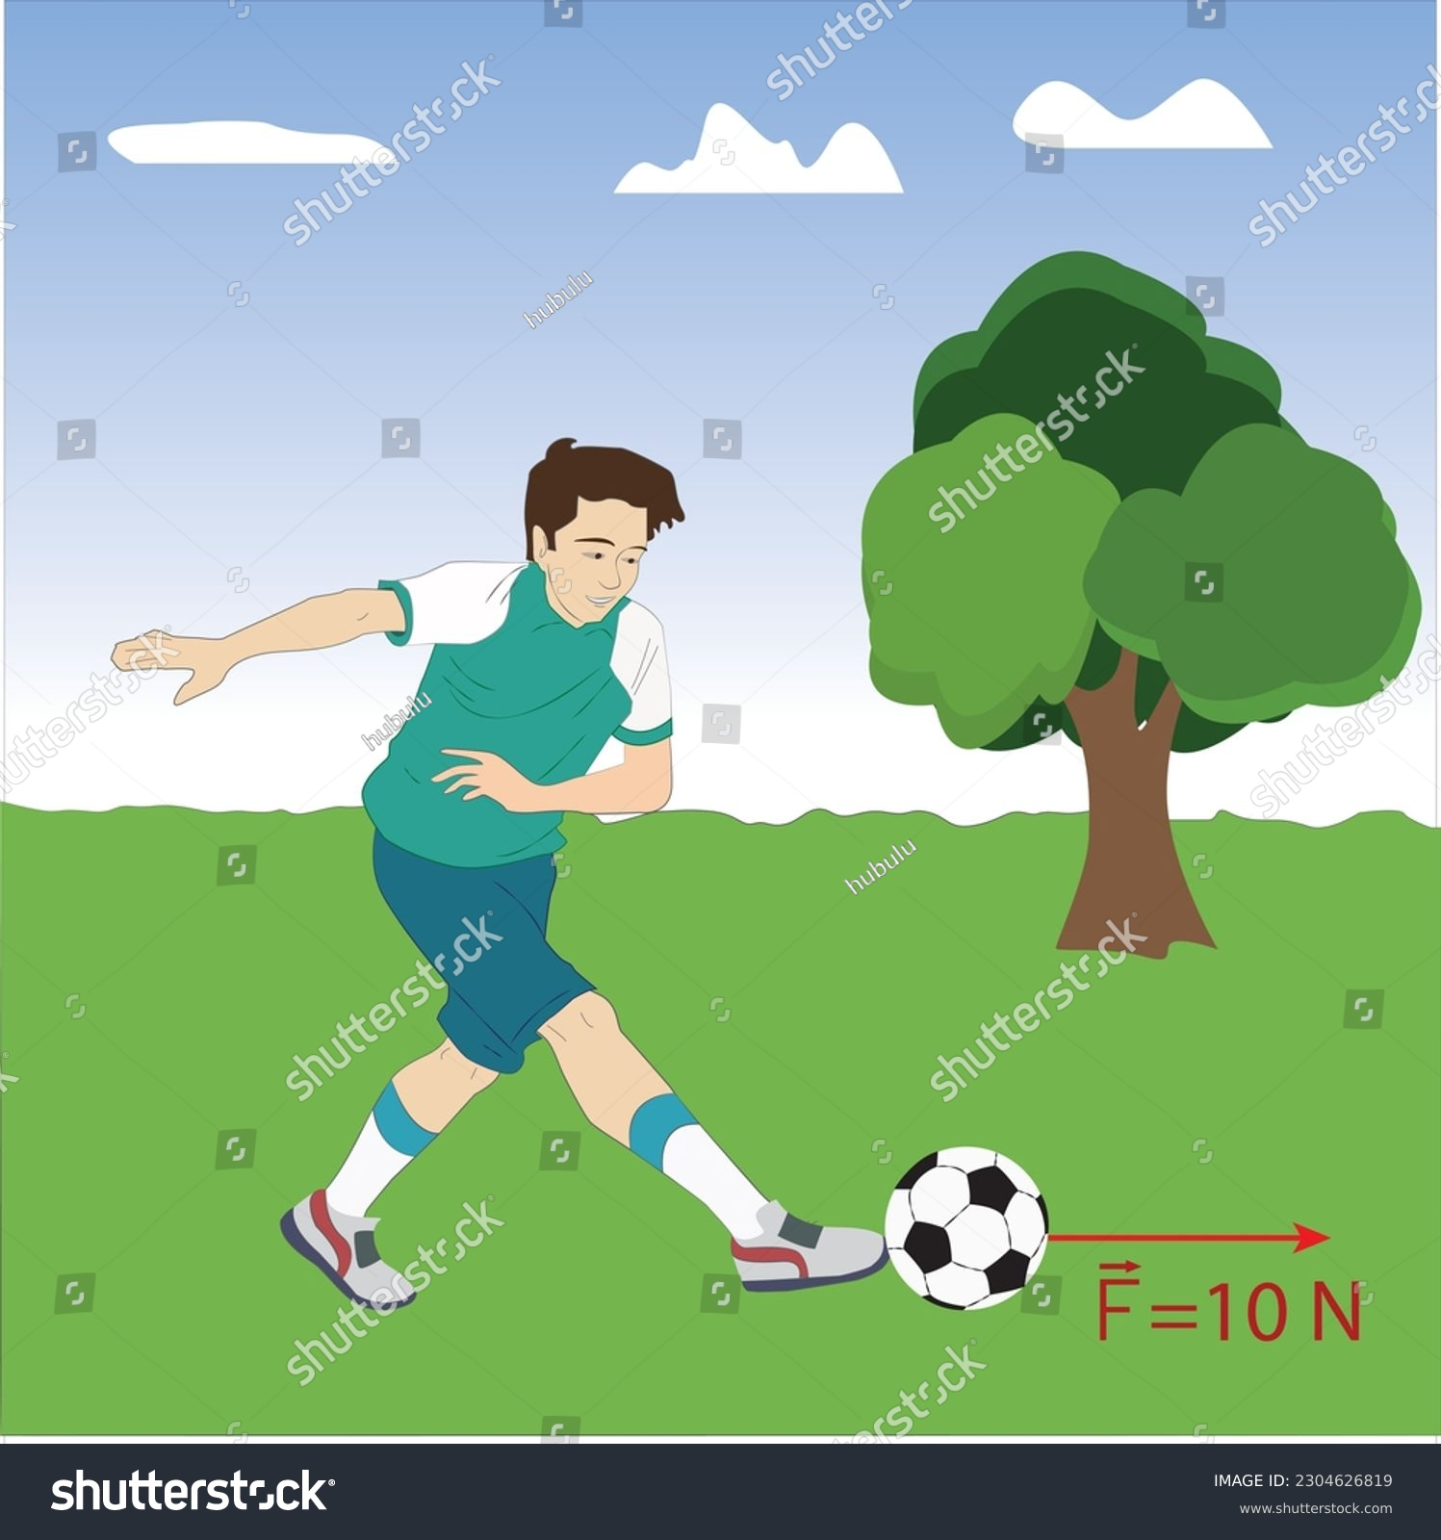
Challenges
What is a touch?
When a significant force is applied to the ball from a player and vice versa.
Challenges
How to measure this force?
How to differentiate this force from other forces; gravity, friction, air resistance, ground touch, goal post touch.
From whom did the touch come from?

Slide 9
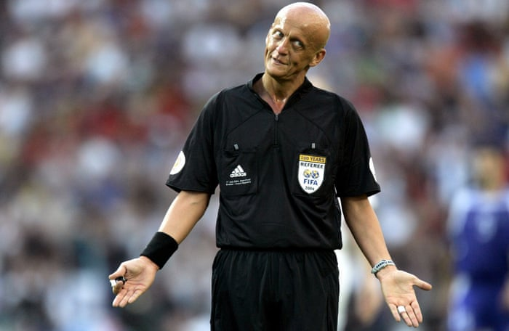
Cases
Normal cases
Dribbling with ball
Passing
Receiving
Shooting
Blocking
Edge cases
Touching both the keeper and goal post
Touching two players at the same time
Scraping the ball
Spinning of the ball
Touching without moving ball

Slide 10
Translation into technical requirements
Applied force from players on ball
Indication of force on the ball
Position of ball and players
IMU?
Heat sensor?
Force sensor?
External ball position?
Ball force prediction?
3D-model position?
Geometrical center?
Orientation?

Slide 11
Summary

